Slide 1
Machine learning
Regent College London
SWE6204

Slide 2
Machine learning
SWE6204

Slide 3

Machine learning
POLYNOMIAL REGRESSION

Slide 4
Module 1 – polynomial regression

Slide 5
Learning objectives
Understand concept of Polynomial Regression
Understand the Overfitting and Underfitting
Understand techniques to overcome Overfitting

Slide 6
Polynomial regression
https://www.youtube.com/watch?v=QptI-vDle8Y
https://serokell.io/blog/polynomial-regression-analysis

Slide 7
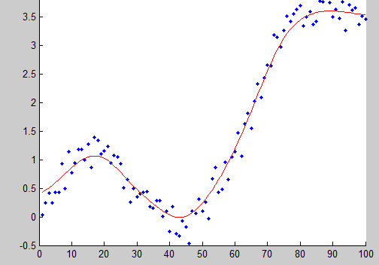
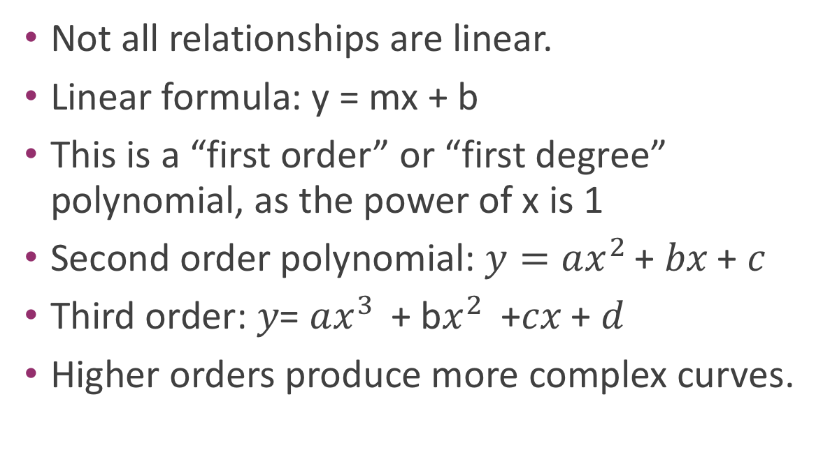
Why limit ourself to straight line
Not all relationships are linear.
Linear formula: y = mx + b
This is a “first order” or “first degree” polynomial, as the power of x is 1
Second order polynomial: $y=ax^{2 }$+ 𝑏𝑥 + 𝑐
Third order: 𝑦= $ax^{3 }$+ b$x^{2 }$ +𝑐𝑥 + 𝑑
Higher orders produce more complex curves.

Slide 8
Overfitting and underfitting
https://www.youtube.com/watch?v=W-0-u6XVbE4

Slide 9
Ways to prevent the overfitting
https://www.javatpoint.com/overfitting-in-machine-learning

Slide 10
Python coding
Let’s play with an example
• numpy.polyfit() makes it easy.

Slide 11
+44 (0)207 016 8000
info@rcl.ac.uk

